Slide 1

Customer Churn Prediction Using Machine Learning
Presented by: [Your Name] · Department of Computer Engineering · A.G. Patil Polytechnic Institute, Solapur

Slide 2
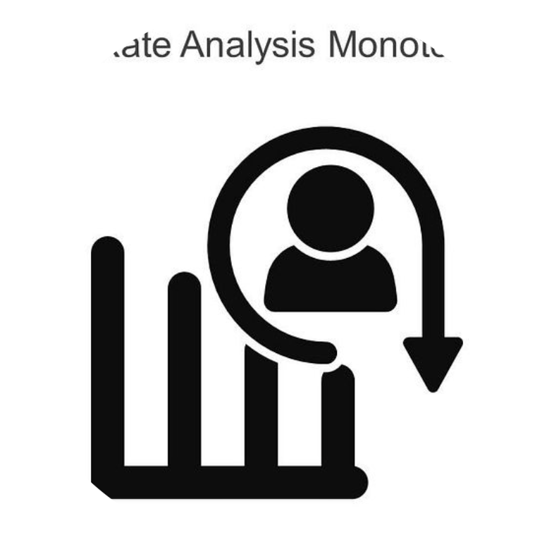
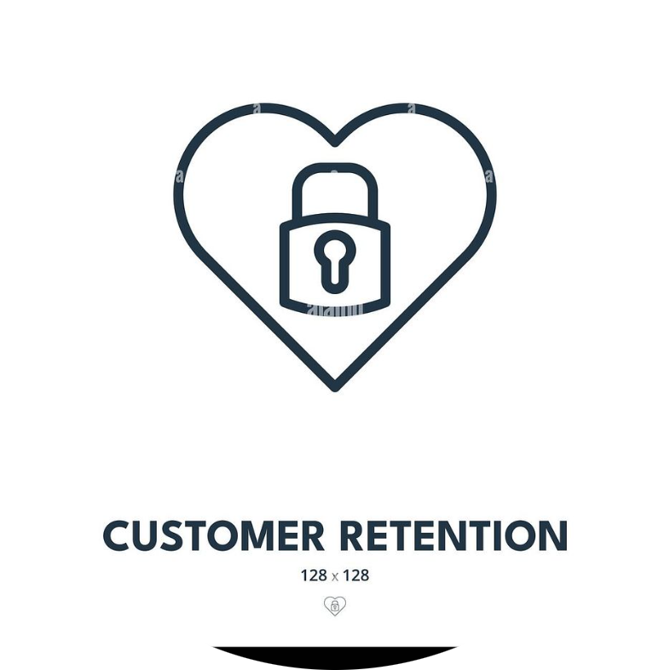
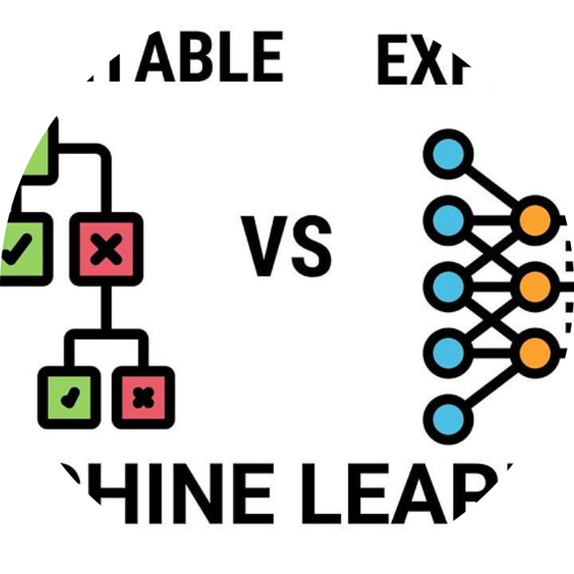
Introduction
What is customer churn?
Why retention matters
Role of machine learning
When customers stop using a product or service — measured as voluntary attrition over a time period.
Retaining customers is more cost-effective than acquiring new ones; small retention gains often drive outsized revenue impact.
ML detects behavior patterns and predicts at-risk customers so interventions can be targeted and timely.

Slide 3
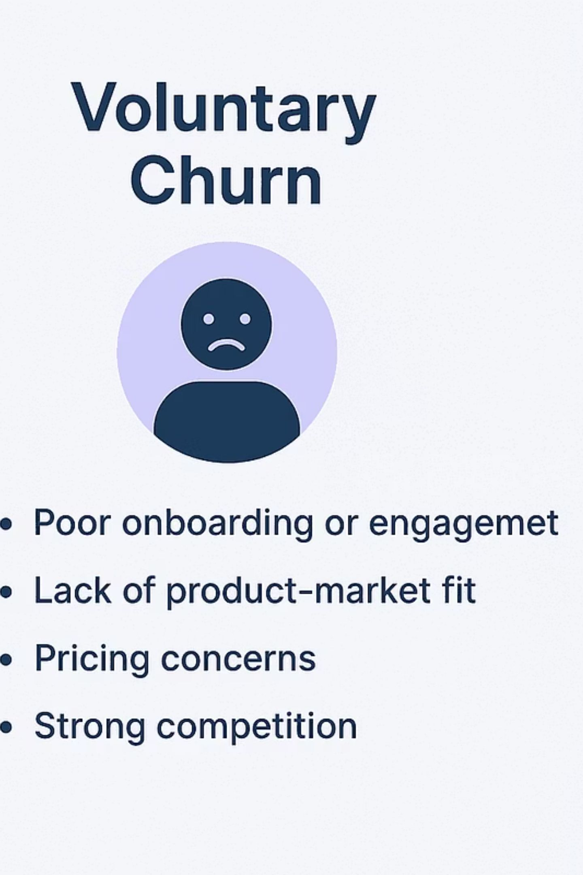
Problem Statement & Objectives
Problem
Objectives
Companies lose customers due to dissatisfaction and disengagement.
Manual churn detection is slow, inconsistent and not scalable.
Predict which customers will churn (binary target).
Identify key factors driving churn for explainability.
Recommend retention strategies based on predictions.

Slide 4







Technology Stack
Python
Pandas & NumPy
Matplotlib
Primary language for data processing and modelling.
Data manipulation, cleaning and numerical operations.
Exploratory visualisations and plots.
Scikit-learn
MySQL
Streamlit
Model building, validation and evaluation tools.
Store historical customer and transaction data.
Interactive dashboard for predictions and recommendations.
Gemini API
Natural-language explanation and enhanced retention-message generation.

Slide 5
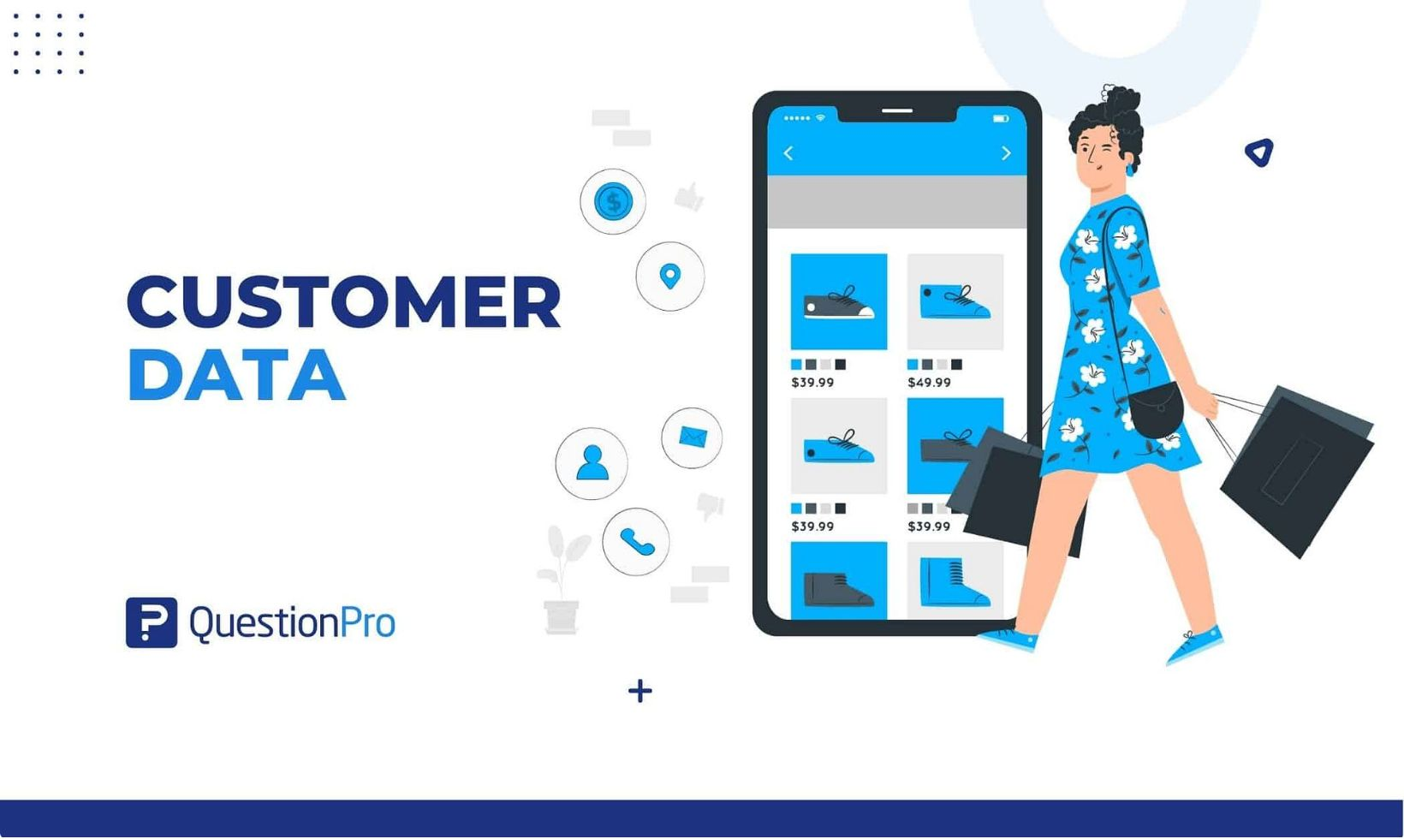
Dataset & Features
Core features used for modelling and interpretation:
Age
Subscription Plan (tiered: Basic / Standard / Premium)
Watch Time (minutes per week)
Login Frequency (logins per week)
Payment Failures (count in last 3 months)
Customer Support Tickets (count + resolved flag)
Satisfaction Rating (1–5)
Churn (target: 0 = retained, 1 = churn)

Slide 6
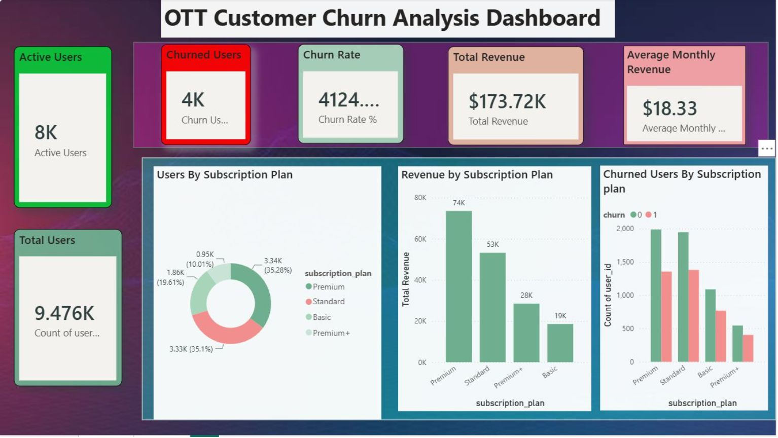
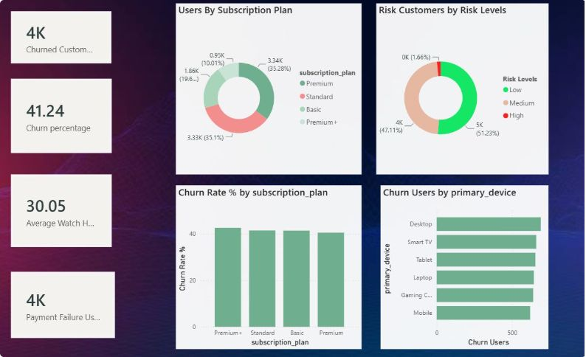
Data Preprocessing & Exploratory Analysis
Data cleaning
Missing values
Encoding
Remove duplicates, standardise date formats, validate numeric ranges.
Impute with median for continuous fields; mode or explicit "unknown" for categorical.
One-hot for Subscription Plan; ordinal encoding for satisfaction where appropriate.
Scaling
StandardScaler for models sensitive to scale (e.g., distance-based features).
Key EDA takeaways: class balance check, strong negative correlation between Watch Time and churn, Payment Failures and low Satisfaction as top risk indicators.

Slide 7

Machine Learning Model & Workflow
Dataset
Preprocessing
Random Forest
Prediction & Explain
01
02
03
Supervised approach
Random Forest
Training & testing
Use labelled historical data to learn patterns associated with churn.
Ensemble tree-based classifier chosen for robustness, interpretability via feature importances, and handling mixed data types.
Stratified train/test split, cross-validation, and metrics: accuracy, precision, recall, F1 and AUC-ROC.

Slide 8
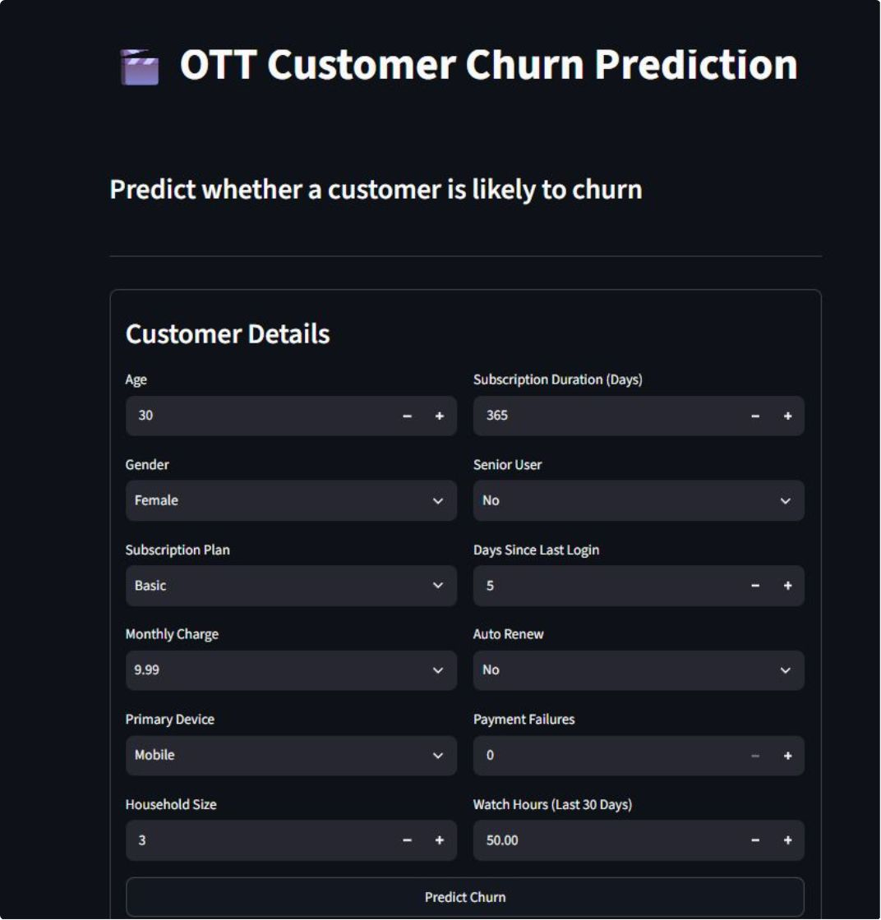




Project Application — Streamlit Dashboard
Customer input
Prediction output
Fields: Age, Subscription Plan, Watch Time, Login Frequency, Payment history, Support interactions.
Churn probability score, binary prediction and confidence interval.
Churn reason
Retention recommendation
Model-backed explanation (e.g., low watch time + recent payment failures).
Suggested actions: personalised offer, payment reminder, targeted content, outreach by support.
Integration: MySQL for user data, Gemini API for natural-language recommendation messages.

Slide 9
Results & Future Scope
85%
78%
Top 3
Model AUC
Precision / Recall
Top features
High separability between churn and retained customers.
Balanced precision and recall after threshold tuning.
Watch Time, Payment Failures, Satisfaction Rating.
Results: Accurate churn prediction with actionable factor identification enabling targeted retention efforts.
Future Scope
Real-time streaming predictions (Kafka / Spark) for live interventions.
Deep learning: sequence models (LSTM/Transformer) on session/time-series data.
Deploy on live OTT platform with A/B testing of retention strategies.
Enhance explanations with SHAP and integrate Gemini for human-friendly recommendations.

Slide 10


Conclusion
Machine learning enables the early identification of at‑risk customers, helping businesses prioritise retention actions. This project integrates data analysis, predictive modelling (Random Forest), a MySQL-backed dataset and a Streamlit application enhanced by Gemini for human-friendly recommendations. The result: measurable reductions in churn risk and a roadmap for real‑time deployment and deeper models.
Thank you

